Slide 1
Teams and Team Models in:
Early Intervention/Early Childhood Special Education (EI/ECSE)

Slide 2
EI/ECSE Standard 3, Component 3.1
Candidates apply teaming models, skills, and processes, including appropriate uses of technology, when collaborating and communicating with families; professionals representing multiple disciplines, skills, expertise, and roles; and community partners and agencies.

Slide 3
DEC Recommended Practices (RPs, 2014)
TC1 Practitioners representing multiple disciplines and families work together as a team to plan and implement supports and services to meet the unique needs of each child and family.
TC2 Practitioners and families work together as a team to systematically and regularly exchange expertise, knowledge, and information to build team capacity and jointly solve problems, plan, and implement interventions.

Slide 4
DEC Recommended Practices (RPs, 2014)
TC3 Practitioners use communication and group facilitation strategies to enhance team functioning and interpersonal relationships with and among team members.

Slide 5
Objectives
Define and describe
The characteristics of effective teams.
Describe and compare
Multidisciplinary, interdisciplinary, and transdisciplinary team models.

Slide 6
Teams and Their Characteristics

Slide 7
“Alone we can do so little; together we can do so much.”
- Helen Keller

Slide 8
Team
Individuals from multiple disciplines and the family who work together to achieve the child and family’s outcomes/goals.
Notes:
Ask learners to think about their current team or other teams for which they were a member as the content for this session is presented.

Slide 9
Characteristics of Teams
Common goal(s).
Interdependence of members.
Belief that working together leads to more effective decisions than working alone.
Accountability as a unit within a larger organizational context.
Notes:
Based on your current team or a former team of which you were a member, what was the larger organizational context?

Slide 10
Effective Teams Adhere to These Principles:
Articulate goal(s).
Articulate role expectations of team members.
Utilize effective communication strategies.
Employ a structured approach to problem-solving and decision-making.
Identify strategies for resolving conflict.
Notes:
Each of these principles will be discussed further during this session, except for communication strategies which will be discussed in another session.

Slide 11
Functions of Teams in EI/ECSE
Assessment,
Individualized program planning – IFSP/IEP development,
Individualized planning for intervention and instruction,
Implementation of intervention and instruction,
Inter- and intra-agency coordination, and
Professional development.

Slide 12
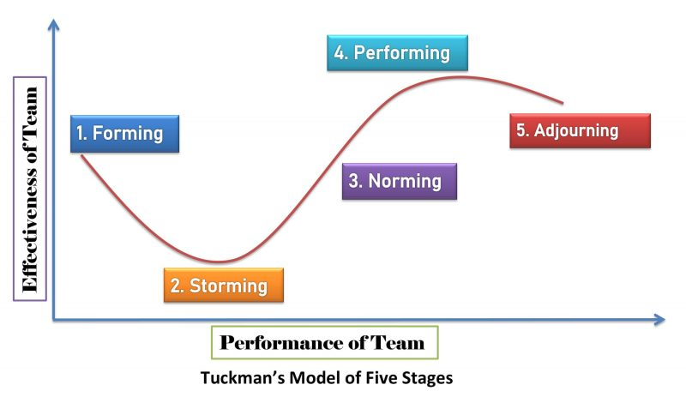
Tuckman’s Five Stages of Team Development
Notes:
Established by psychologist Bruce Tuckman in his 1965 paper "Developmental Sequence in Small Groups," Tuckman's stages of group development are the common steps most teams take during their development and establishment. The original paper identified four stages, with the fifth stage added later.
Tuckman's five stages of group development each represent a different process that goes into reaching the group's goals:
1. Forming
In the forming stage, the group is just getting to know one another. Usually, there's a group leader present who, in the first few group meetings, manages most of the agenda. Often, group members are overly polite and positive during the forming stage of group development. It's usually easy to tell when you're in the forming stage of group development, as it should be the very first step in the progression. Some characteristics of this stage include:
Introduction of team members and their hobbies, interests and skills
Polite, quiet team members
Reliance on the group leader
Focus on establishing roles, responsibilities and goals
Development of a project timeline
For some groups, the forming stage lasts for just the first meeting, while for others the forming stage may linger for a couple of meetings.
2. Storming
The storming stage of group development is often contentious. In this phase, group members become comfortable enough to voice concerns, which might lead to conflict and in-fighting within the group. Group members might attempt to establish powerful positions and unseat the group leader. Signs your group has moved from forming to storming include:
Conflicts arise during meetings or work sessions
The team questions the authority of the leader or supervisor
Team members work to establish what their roles and responsibilities are within the project
The team functions more as individual members than as a cohesive unit
It's important to remember that conflict within a team is both healthy and normal. Most teams can move past the storming stage and become a well-functioning and productive team.
3. Norming
In the norming stage of group development, the team has effectively resolved most, if not all, conflicts and can productively work on the project or towards the end goal. The team members know each other well at this stage and feel comfortable working together or seeking input from one another. Signs your team has reached the norming stage of group development include:
Conflicts are much less frequent, and if they do arise, it's easy to solve them
All team members understand their specific roles and responsibilities
The team leader helps delegate work and answers any questions from the team
The team might socialize together outside of a professional setting
The norming phase can last for an extended period of time, or the team can pass through it quickly and go to the next stage: performing.
4. Performing
The performing stage of group development is where you should usually try to spend the majority of your time. In the performing stage, productivity and efficiency are extremely high. Group members are not only comfortable with one another, but they're also comfortable with their work and expectations. You'll know you're in the performing stage of group development when:
The leader rarely intervenes but instead helps facilitate only when needed
Team members work autonomously on tasks
The project is nearing completion
Any conflict is usually constructive and related directly to the project rather than personal disagreements
Often, teams complete their projects during the performing stage of group development. In an ideal scenario, the team spends the majority of their time in the performing stage as it's thought to be the most productive and leads to goal achievement.
5. Adjourning or mourning
In Tuckman's original paper, the performing stage was the final step in the group development process. However, in 1977 he, along with his colleague Mary Ann Jensen, identified the fifth stage of development called either adjourning or mourning. In this stage, the team separates after the conclusion of their work together. Signs you've reached this stage include:
Sadness at the project's ending
Uncertainty about the future
A sense of loss over the separation of the team

Slide 13
Tuckman’s Five Stages of Team Development
Tuckman’s Five Stages of Team Development (1:27)
What are Tuckman’s five stages?
What are the main characteristics of each stage?
For a team in which you are currently a member, identify the team’s stage of development.
Notes:
This video briefly describes Tuckman’s five stages of team development. As you watch the video, listen for responses to the questions on the slide.

Slide 14
Team Members in EI/ECSE

Slide 15
The Family
The family is an equal partner in decision-making on both Part C and Part B/619 teams.

Slide 16
Service Providers IDEA Part C (303.13)
Audiologists
Family therapists
Nurses
Occupational therapists
Orientation and mobility specialists
Pediatricians, other physicians
Physical therapists
Psychologists
Registered dieticians
Social workers
Special educators
Speech language pathologists
Vision specialists
Notes:
Any of the related services professionals identified in IDEA may potentially be members of the team for children ages three through five years. The specific professionals represented will depend on the child and family’s IFSP and the services specified in it. The most common professional disciplines represented are special educators (i.e., ECSE), occupational therapists, physical therapists, and speech language pathologists.

Slide 17
IDEA Part B/619 Educators
ECSE – preschool, kindergarten teachers
Regular education teachers

Slide 18
Related Service Providers IDEA Part B/619 (Sec. 300.34)
Audiologists
Social workers
Psychologists
Licensed physicians
Occupational therapists
Orientation and mobility specialists
Physical therapists
Recreation specialists
School nurses
Speech language pathologists
Interpreters
Notes:
Any of the related services professionals identified in IDEA may potentially be members of the team for children ages three through five years. The specific professionals represented will depend on the child’s IEP and the services specified in it. The most common professional disciplines represented are occupational therapists, physical therapists, speech language pathologists, and psychologists (primarily for assessment).

Slide 19
Team Models in EI/ECSE

Slide 20
Team Models in EI/ECSE
Multidisciplinary
Interdisciplinary
Transdisciplinary

Slide 21
Multidisciplinary Team Model
Discipline specific, well-defined roles,
Team functions planned and implemented independently, and
Communication primarily in required meetings (e.g., IFSP, IEP).
Notes:
This team model is sometimes compared to parallel play in which team members “act” independently of each other even when in meetings.

Slide 22
Interdisciplinary Team Model
Discipline specific roles.
Services provided by discipline specific team member.
Team members meet and/or communicate regularly.
Notes:
The interdisciplinary team model may be described as similar to associative play in which each team member provides services based on their respective discipline. However, there is some regular communication among team members regarding those services.

Slide 23
Transdisciplinary Team Model
Roles shared across disciplines and with the family.
Shared objectives/outcomes based on IFSP or IEP.
Ongoing communication among team members.
Characterized by the role release process.
Notes:
The team, including the family, jointly plans, implements, and evaluates progress on IFSP outcomes or IEP objectives. Regular communication occurs across team members both informally and in scheduled meetings or other types of communication. In a home or community Part C setting, professional team members share the practices and strategies that they would use with that child and caregiver to facilitate one team member partnering with the team member to provide those services. In a preschool setting, a team member (e.g., PT) may go into the classroom and work with the child while modeling for the teacher or paraprofessional the strategies that they use to facilitate the child’s involvement in all the classroom activities in order for the classroom staff to then use those strategies.

Slide 24
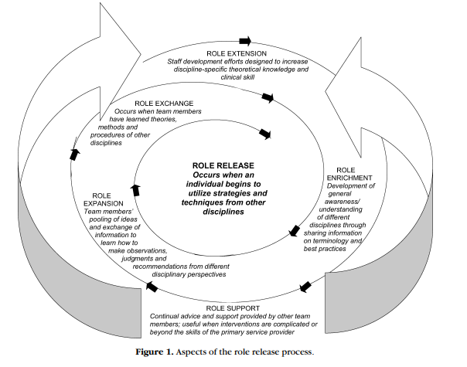
The Role Release Process (King et al., 2009)
(King et al., 2009)
Notes:
King et al. (2009) identify the role release process as one of the identifying features of the transdisciplinary model. They describe it as a spiral process that also includes role extension, role enrichment, role expansion, role exchange, and role support. Each of these is defined on the next slides.

Slide 25
Role Release Process
Role extension – increasing depth of knowledge/skill in each team members’ own discipline
Role enrichment – teaching/learning concepts, information, language across disciplines
Role expansion – increasing knowledge and skills across disciplines
Role exchange – apply new skills while supervised by team member from that discipline
Role release – integrate practices and interventions from other disciplines
Role support – periodic observation and consultation by discipline specific team members

Slide 26
Role Release Activity
Janella’s Story (11:33)
What aspects of the role release process are exemplified in the video?
How are other team members involved?
What does the mother identify as benefits of the transdisciplinary model? The EI?
Notes:
The video illustrates how an EI worked with her team members, including the family, to help 27-month-old Janella maker her choices known and participate in play and family routines. As you watch and listen to the video, think about the questions on the slide. Be prepared o discuss the questions after watching the video.

Slide 27
Advantages/Disadvantages of the Transdisciplinary Team Model
Advantages
Disadvantages
Family equal team member,
Regular meetings,
Team members gain information and practices,
One primary provider, and
Other professional team members in consultant role.
Leadership support critical,
Time for meetings,
Commitment of all team members to model,
Team members willing to share expertise with other team members, and
Funding policies.
Notes:
Advantages – Services are coordinated in this model through ongoing communication and inclusion of the family as an equal team member. Services are typically provided by one primary service provider with the other professionals on the team serving in a support role sharing information about their discipline and skills with other team members. In EI, this is typically advantageous for the family who can develop good rapport with one professional and not have multiple providers coming into the home.
Disadvantages – Leadership support is critical for this model to be effective as time is needed for team members to meet, share their expertise with other team members, and communicate in other ways on an ongoing basis. In addition, all team members must be committed to this model and be willing for other team members to implement practices relevant to their discipline with their support. Financial support is also needed for this model. However, in many Part C programs, providers are only reimbursed for direct services with children and families and not time spent collaborating with team members. And in center-based programs, funding may be very limited for related services professionals. Thus, allowing time for services for children, not team meetings, etc.

Slide 28
When Role Release May Not Be Appropriate?
Child with specific diagnosis that requires expertise of a specific discipline,
Child with specific issues (e.g., feeding), and
Child who is medically fragile.
Notes:
Some children may have a significant medical and/or biological condition that requires the expertise of a specific discipline to ensure that the services provided meet the needs of the child and family and “do no harm”. For some children and families, professionals from two disciplines may provide the services together, referred to as “co-treatment” in some states. As the family’s priorities and concerns change and the child develops, role release may become an option.

Slide 29
How Services Are Provided Based on the Team Model
 | Multidisciplinary | Interdisciplinary | Transdisciplinary
Assessment | Separate | Separate | Team members and family engage in comprehensive assessment together
Family participation | Meet w/individual disciplines | Meet with team or team rep | Full and active members of team
Service plan development | Separate plans by discipline | Share separate plans with one another | Team and family develop together based on family priorities, needs
Service plan responsibility | Responsible for their section | Responsible for sharing information as well as implementation of their section | Team responsible for how primary service provider implements every section of the plan
Service plan implementation | Implement discipline-specific section of the plan individually | Team members implement their section of the plan individually and incorporate other sections where possible | A primary service provider (can change over time) is assigned to implement plan with family: need for disciplines to share their knowledge with others to ensure full implementation
Lines of communication | Informal lines | Periodic case-specific meetings | Regular team meetings where continuous transfer of information occurs between all members of the team
Notes:
Adapted from Woodruff & Hanson, (1987), this table shows how each team model, listed on the top line, performs assessment; includes families; and develops, takes responsibility for, and implements the service plan (IEP, IFSP). On the bottom row, you can see how each service model uses communication to collaborate and coordinate provision of services.

Slide 30
Activity: Multidisciplinary, Interdisciplinary, or Transdisciplinary?
For each of the examples below, determine if the multidisciplinary, interdisciplinary, or transdisciplinary model is being used.
_____ Three-year-old is being assessed individually by a PT, OT, SLP, and School Psychologist for possible developmental delay and each writes a summary report.
_____ The EI provider makes a home visit to the Garcia family one time per week and implements the motor, communication and cognitive outcomes from the child’s IFSP in collaboration with the mom. The EI provider meets with the other team members to discuss the child’s ongoing intervention and progress.
_____ The PT, SLP, and EI provider each go to the ABC Childcare one time per week and work with a 1 ½ year old with Down syndrome on their IFSP outcomes. They meet monthly to discuss progress, changes in status, and any changes in intervention.
Notes:
Ask the learners to apply what has been discussed to identify which team model is being represented in each example and to have a rationale for the team model identified.

Slide 31
References and Resources
Code of Federal Regulations (eCFR). (2021). Part 303 – Early intervention for infants and toddlers with disabilities. National Archives. https://www.ecfr.gov/current/title-34/subtitle-B/chapter-III/part-303#303.13
Division for Early Childhood (DEC). (2014). DEC recommended practices. DEC. https://www.dec-sped.org/dec-recommended-practices
Early Childhood Personnel Center (ECPC). (n.d.). ECPC curriculum modules: Professional Standards, Standard 3: Collaboration and teaming . ECPC. https://ecpcta.org/curriculum-module/standard-3-collaboration-and-teaming/
King, G., Strachan, D., Tucker, M., Duwyn, B., Desserund, S., & Shillington, M. (2009). The application of a transdisciplinary model for early intervention services. Infants and Young Children, 14, 1-13.
Tuckman, B., & Jensen, M. (1977). Stages of small group development. Group and Organizational Studies, (2), 419-427.
U.S. Department of Education. (n.d.). IDEA: Individuals with Disabilities Education Act, Sec.300.34. U.S. Department of Education.
Woodruff, G., & McGonigel, M. J. (1988). Early intervention team approaches: The transdisciplinary model. In J. B. Jordan, J. J. Gallagher, P. L. Hutinger, & M. B. Karnes (Eds.), Early childhood special education: Birth to Three (pp. 163-181). Council for Exceptional Children and Division for Early Childhood.

Slide 32
Disclaimer
This is a product of the Early Childhood Personnel Center (ECPC) awarded to the University of Connecticut Center for Excellence in Developmental Disabilities and was made possible by Cooperative Agreement #H325B170008 which is funded by the U.S. Department of Education, Office of Special Education Programs. However, those contents do not necessarily represent the policy of the Department of Education, and you should not assume endorsement by the Federal Government

