Slide 1
Communication for Effective Teaming in:
Early Intervention/Early Childhood Special Education (EI/ECSE)

Slide 2
EI/ECSE Standard 3, Component 3.1
Candidates apply teaming models, skills, and processes, including appropriate uses of technology, when collaborating and communicating with families; professionals representing multiple disciplines, skills, expertise, and roles; and community partners and agencies.

Slide 3
DEC Recommended Practices (RPs, 2014)
TC2 Practitioners and families work together as a team to systematically and regularly exchange expertise, knowledge, and information to build team capacity and jointly solve problems, plan, and implement interventions.
TC3 Practitioners use communication and group facilitation strategies to enhance team functioning and interpersonal relationships with and among team members.

Slide 4
Objectives
Describe
Active listening strategies.
Identify
Processes for problem-solving and conflict resolution.
Identify and describe
Alternative means for communication within the team.

Slide 5
Communication
The process of sending and receiving information and ideas between individuals using a common system of symbols, signs, or behavior.

Slide 6
Communication Strategies Include:
Active listening
Nonverbal communication
Paraphrasing
Questioning
Notes:
Today, we will be discussing several communication strategies that can be used within teams to facilitate collaboration. Active listening is essential to effective communication. Several other strategies are used to facilitate listening and to let the speaker know that what they are saying is important and being heard. These are nonverbal communication, paraphrasing, and questioning. Each of these will be discussed in more detail.

Slide 7
Listening
Listening is the process of receiving, interpreting, and reacting/responding
to a message from
another person.

Slide 8
Why Listen?
To obtain information,
To understand,
To learn, and
For enjoyment.
Notes:
There are several purposes for listening. These include to obtain information. For example, on an EI team, you may need more information about when mealtime occurs in the family. It is also important to understand the message being conveyed. The preschool teacher may be focusing on how the PT recommends that a child be positioned during circle time. Listening also involves learning more about something. The OT may share why certain activities help promote eye-hand coordination. And listening can also be for pleasure (e.g., listening to music).

Slide 9
Active Listening
A conscious effort to hear the words that another person says and more importantly, the complete message that person is attempting to communicate.
Notes:
Listening is one of the most important skills you can have. Being able to do it well has a positive impact on all aspects of your life, including how effective you are at work. Research suggests, however, that we only remember 25-50 percent of what we hear, meaning that we could be missing important messages.

Slide 10
Active Listening Techniques
Pay attention,
Show that you are listening,
Provide feedback,
Defer judgment, and
Respond appropriately.
Notes:
Active listening includes these five techniques. Watch the video to learn more about what each of these entail.

Slide 11
Improve Your Listening Skills with Active Listening
Improve Your Listening Skills with Active Listening (2:39)
Watch the video and:
Describe the five active listening techniques.
Reflect on which techniques you currently use.
Reflect on which technique(s) you want to practice improving.

Slide 12
Nonverbal Communication to Demonstrate Listening
Eye contact,
Facial expressions,
Head nods,
Leaning forward,
Arm movement,
Body posture, and
Utterances such as, “yes”, “unhum”.
Notes:
These nonverbal communication strategies are indicators that a person is paying attention and listening to the speaker.

Slide 13
Paraphrasing
Why – to clarify or verify a point(s) the speaker made,
How - summarize what the speaker said, and
How – ask the speaker if that is accurate or what they intended to communicate.
Notes:
The primary purpose of paraphrasing is to clarify or verify what the speaker has said and if what you have paraphrased is not accurate, the speaker can correct that.

Slide 14
Asking Questions
Open-ended questions – require thought and more than one-word response; more comprehensive answer based on speaker’s knowledge.
Close-ended questions – require a one-word or short phrase response.
Notes:
Examples of open-ended questions – What is a typical day for Joshua? What are Lily’s favorite toys? What do you think will happen if….?
Examples of close-ended questions – What is Kanesha’s birthday? Do Terek and Liam play together?

Slide 15
Connect Video 3.4: Conversation with Examples of Seeking and Verifying Information
Connect Video 3.4: Conversation with Examples of Seeking and Verifying Information (2:39)
Watch the video and identify:
Examples of the five active listening techniques.
Examples paraphrasing (i.e., clarifying, verifying).
Examples of open and close ended questions.

Slide 16
Barriers to Effective Listening
Environmental conditions,
Distance from speaker,
Attitude of the listener,
Speed of speaking,
Speaker’s nonverbal communication, and
Language of the speaker.
Notes:
Environmental conditions – Factors such as the temperature, humidity, ventilation, acoustics, lighting, etc. of the space may impact attention and listening.
Distance from the speaker – The farther from the speaker, the more likely the listening process will be impacted and some words not heard or misunderstood. This may be exacerbated if the listener has a hearing loss.
Attitude of the listener – Some listeners may judge what the speaker is saying or what they think they will be saying. For example, the EI or preschool teacher may consider themselves the professional and the expert on child development and devalue what the parent is saying. Or, this is a family with whom the EI or teacher has been working with and thinks they can predict what is going to be said, so stop listening.
Speed of the speaker – Some individuals may speak very fast, making it difficult for some listeners to concentrate on what they are saying. Some may speak slowly and hesitantly, resulting in some listeners distracted by wanting them “to move on” with what they are saying.
Speaker’s nonverbal communication – Some speakers may use little or no verbal cues such as facial expressions, eye contact, gestures, etc. to help convey the meaning of their message or the feeling behind the message.
Language of the speaker - Some speakers may use a very quiet voice or monotone when talking, thus, making it difficult to maintain listening. Others may have a dialect or accent that requires extra attention. Still other speakers may need an interpreter (e.g., sign language, another verbal language), again, often requiring more intense concentration on the part of the listener.

Slide 17
Problem Solving
The process of identifying
a problem, developing
possible solutions, and
taking a course of action.

Slide 18
Stages of Problem Solving
Identify the problem.
Define the context of the problem.
Explore possible solutions.
Select the perceived “best” solution.
Implement the selected solution.
Monitor outcomes and seek feedback.
Notes:
Identify the problem – State the problem specifically and identify what aspect of the team’s goal(s) is/are being impacted.
Define the context of the problem – Specify any underlying causes, gather any available data to clarify the problem, determine and collect any additional resources needed to clarify the problem.
Explore possible solutions - Involve the entire team in generating possible solutions, ensure that possible solutions align with the team’s and program’s goals, identify both short-term and long-term solutions.
Select the “best” solution – Evaluate possible solutions in relationship to the team’s goal(s) and desired outcome(s), consider all possible solutions without bias, state the selected solution explicitly.
Implement the selected solution – Plan for and implement.
Monitor outcomes and seek feedback – Develop measures for monitoring and collect data, gather feedback from all relevant consumers/stakeholders of the implementation, evaluate outcomes.

Slide 19
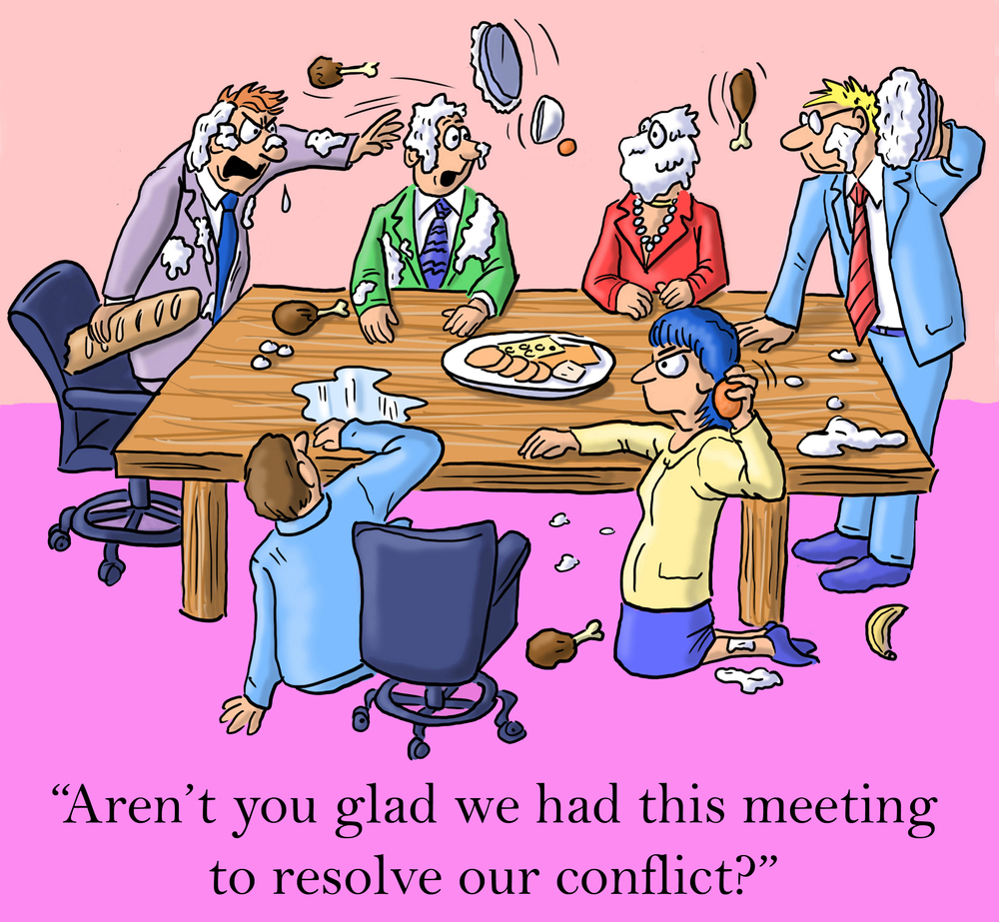
Conflict Resolution

Slide 20
Conflict
A serious
disagreement between
two or more individuals.
Notes:
Read the definitions of conflict and conflict resolution.
Some may think that conflict is negative and disruptive to a team’s performance and ability to achieve its goals. However, if resolved in a way to reach a solution to the conflict it can result in positive change and team growth and improved interactions.
However, unresolved conflicts will likely lead to dysfunctional team functioning. An impartial party will often be needed to “mediate” the conflict resolution. This could be someone within the team who takes the lead in doing this, or someone external to the team. The next slide will identify five steps in the conflict resolution process.

Slide 21
Conflict Resolution: Definition
The process by which
two or more individuals find a peaceful solution
to their dispute.

Slide 22
Conflict Resolution: A Five Step Process
Clarify what the conflict is.
Establish a desired outcome for the conflict.
Discuss possible solutions for achieving the common outcome.
Decide on the best solution for resolving the conflict.
Agree on a solution and the responsibilities of each individual.
Notes:
Define the source of the conflict – Identify the specific point(s) of disagreement. Each party should agree on what the disagreement is. This may involve a discussion of what needs are not being met, what the “real” issue(s) are, and what the differing points of view are.
Establish a desired outcome for the conflict – Each individual agrees to an acceptable outcome for the conflict.
Discuss possible solutions for achieving the common outcome – This step involves brainstorming possible solutions/strategies for meeting the common outcome. It will involve each individual listening to the other(s) and working together to identify how the outcome can be met.
Decide on the best solution for resolving the conflict – All individuals involved agree on the best solution or the solution that all “can live with”. This step also includes discussing what led to the conflict and how that can be prevented in the future.
Agree on a solution and the responsibilities of each individual – Each individual involved in the conflict verbally states that they agree to the solution and what their responsibility is in maintaining the solution.

Slide 23
Visual Example of the Five Different Conflict Resolution Styles
Visual Example of the Five Different Conflict Resolution Styles (3:34)
Watch the video and identify:
The different conflict resolution styles that you observe in your current team.
The style that is most representative of you.
The style(s) that seem(s) most conducive to resolving conflicts in a team. Why?
Notes:
Each of us tends to approach conflict differently. This video identifies using media clips, five styles of approaching conflict: avoidance, competition, compromise, collaboration, and accommodation.

Slide 24
Communicating with Interpreters

Slide 25
IDEA States That The Team Must:
(iv) Consider the communication needs of the child, and in the case of the child who is deaf or hard of hearing, consider the language and communication needs, opportunities for direct communication with peers and professionals in the child’s language and communication mode, academic level, and full range of needs including opportunities for direct instruction in the child’s language and communication mode, and (v) Consider whether the child requires assistive communication devices and services.” IDEA Sec. 1414 (d) (3) (B)

Slide 26
IDEA Also States That:
Use of interpreters or other action, as appropriate. The public agency must take whatever action is necessary to ensure that the parent understands the proceedings of the IEP Team meeting, including arranging for an interpreter for parents with deafness or whose native language is other than English. Sec.300.322(e)

Slide 27
Need for Sign Language Interpreters (CDC, 2017)
Over 98% of U.S. newborns received a hearing screening.
About 6,500 U.S. infants were identified with a permanent hearing loss
The prevalence of hearing loss in 2017 was 1.7 per 1,000 babies screened.
It is unclear as to how many of these children communicate with sign language.

Slide 28
Need for Foreign Language Interpreters
According to the most recent U.S. Census data:
One out of five children live in families where at least 1 parent was foreign born.
Of those children, 26% live in households where no one over 13 years old speaks English fluently.

Slide 29
Roles of Interpreters
Conduit – acts as means for what is said by one individual to reach another individual.
Clarifier – checks for understanding of what is said and asks speaker to repeat or state/sign in a different way.
Cultural broker/mediator – detects cultural misunderstandings and provides cultural framework to clear up the misunderstanding.
Notes:
Conduit – This is the primary role of the interpreter who communicates everything exactly as it is said. The interpreter should reflect the tone, volume, and inflection of the speaker. The interpreter also manages the flow and speed of the conversation. First person language is used in this role.
Clarifier – If signs of confusion are evident, the interpreter must ask permission and have a signal to interrupt the communication process. The interpreter, using third person (e.g., Tanya would like to…), requests an unfamiliar word/phrase be simplified, or, if there is no equivalent word/phrase in either language use analogies/word pictures.
Cultural broker/mediator – This role is based on the interpreter having knowledge of the culture represented.
Advocate – This role is sometimes included as a 4th role. In this role, the interpreter acts on certain issues that they think are necessary for the family/child to get the services needed.

Slide 30
Things to Consider When Working With Interpreters
Review the tips for working with sign language and language interpreters:
10 Tips for Using a Sign Language Interpreter
Best Practices for Communicating Through an Interpreter
Identify the similarities and difference in the tips and practices provided.
Which do you think will be the easiest to implement? The most difficult?
Notes:
Note: The Best Practices for Communicating Through an Interpreter link is designed for health care professionals, so “patient” is used. Practices would be the same in an EI/ECSE setting.

Slide 31
Communicating With Technology

Slide 32
Using Video to Promote Communication
Use of video can assist professionals and the family to:
Review child and adult performance, make recommendations, and monitor progress.
Facilitate reflective and constructive feedback on specific interventions.
Support decision-making about individual goals/outcomes.

Slide 33
Using Video Conferencing to Promote Communication
Make home visits and co-visits,
Conduct team meetings,
Attend center-based programs virtually,
Promote family to family connections,
Conduct observations of staff and provide reflective supervision, and
Provide professional development activities.
Notes:
The ECTA hand-out authored by Larry Edelman (URL in the reference list below) provides tips for implementing the above, along with more specific tips for home visitors and meeting hosts. It also has video examples of videoconference and other resources.

Slide 34
Compliance with Federal Policy
U.S Department of Health and Human Services and the U.S. Department of Education’s Office of Special Education and Rehabilitation announced that compliance with HIPAA, IDEA, Section 504 of the Rehabilitation Act, and Title II of the Americans with Disabilities Act are NOT barriers to using video conferencing. (Edelman, 2020)

Slide 35
Using Video and Video Conferencing to Enable Team Meetings over Distances
Using Video and Video Conferencing to Enable Team Meetings over Distances (6:35)
Watch the video and:
Reflect on the benefits of virtual meetings for team members that were identified.
Reflect on the challenges of virtual meetings for team members that were identified.
Identify, based on your participation in videoconferencing, additional benefits and challenges you have experienced?
Notes:
This video from the Ohio Developmental Disabilities Council illustrates a number of ways that video and video conferencing are being used to enhance supports for families and team functioning.

Slide 36
References and Resources
Centers for Disease Control (CDC). 2017 Annual data early hearing detection and intervention (EHDI) program summary. CDC.
https://www.cdc.gov/ncbddd/hearingloss/ehdi-data2017.html
Division for Early Childhood (DEC). (2014). DEC recommended practices. DEC.
Early Childhood Personnel Center (ECPC). (n.d.). Curriculum modules: Professional standards – standard 3. ECPC.
Edelman, L. (2020). Video conferencing 101. Early Childhood Technical Assistance Center. https://ectacenter.org/~pdfs/topics/disaster/Video_Conferencing_101.pdf
U.S. Department of Education. (n.d.). IDEA: Individuals with Disabilities Education Act, Sec.1414 (d) (3) (B). U.S. Department of Education.
U.S. Department of Education. (n.d.). IDEA: Individuals with Disabilities Education Act, Sec.300.322. U.S. Department of Education.

Slide 37
Disclaimer
This is a product of the Early Childhood Personnel Center (ECPC) awarded to the University of Connecticut Center for Excellence in Developmental Disabilities and was made possible by Cooperative Agreement #H325B170008 which is funded by the U.S. Department of Education, Office of Special Education Programs. However, those contents do not necessarily represent the policy of the Department of Education, and you should not assume endorsement by the Federal Government.

