Slide 1
Using Responsive and Reciprocal Interactions, Interventions, and Instruction
Initial Practice-Based Professional Preparation Standards Early Interventionists/Early Childhood Special Educators
6.3

Slide 2
Standard 6
Candidates plan and implement intentional, systematic, evidence-based, responsive interactions, interventions, and instruction to support all children’s learning and development across all developmental and content domains in partnership with families and other professionals. Candidates facilitate equitable access and participation for all children and families within natural and inclusive environments through culturally responsive and affirming practices and relationships. Candidates use data-based decision-making to plan for, adapt, and improve interactions, interventions, and instruction to ensure fidelity of implementation.

Slide 3
Component 6.3
Candidates engage in ongoing planning and use flexible and embedded instructional and environmental arrangements and appropriate materials to support the use of interactions, interventions, and instruction addressing developmental and academic content domains and are adapted to meet the needs of every child and their family

Slide 4
Objectives
Describe an ongoing and flexible planning process to support interactions, interventions, and instruction addressing developmental domains designed to meet the needs of each child and family.
Describe the use of embedded instruction, environmental arrangements, and appropriate materials addressing developmental domains designed to meet the needs of each child and family.

Slide 5
Objectives, continued
Describe examples of adaptations to use to support interactions, interventions, and instruction addressing developmental domains to meet the needs of each child and their family

Slide 6
Planning for Interaction and Learning for Children With Delays/Disabilities
Individual child goals and general classroom curriculum are intentionally fused
What changes are needed in the preschool environment and curriculum to ensure full participation?
How will progress be meaningfully monitored?
Notes:
With a commitment to the full participation of every child, just a little bit of intentionality can make sure that the goals of a child with an IEP can be integrated into the general classroom curriculum.
Most of the time, only small changes are needed to make a big impact on child outcomes! Early childhood programs and teachers can systematically plan how to offer a child with a delay or a disability just the right amount of help (e.g., Sandall et al., 2019) to participate and succeed in everyday learning opportunities with peers.
Similarly, by creating simple ways of observing and recording data about how a child is progressing, teachers and other EI/ECSE providers, and families can make sure that instruction and intervention strategies are meeting the needs of the child, and identifying exactly how curriculum plans may need to be changed over time.

Slide 7
Individualized Planning
Ensures that the child’s learning environment and experiences are:
Safe
Engaging
Culturally and linguistically relevant
Inclusive of a wide range of learning opportunities
Supported by families

Slide 8
Embedded Learning Opportunities
Short, intentional teaching episodes focused on child objectives and embedded into planned activities and routines in school or with family
Do not require big changes to classroom
Take advantage of child interests
Offers an opportunity to practice new skills across a variety of social contexts

Slide 9
Embedded Learning Opportunities:
The Basic Steps
Operationalize the learning objective
Gather baseline data
Create a simple activity matrix to choose an activity
Design the instructional interaction and write it on a planning form
Implement as planned providing clear instructions, let the child respond, provide feedback
Record responses/opportunities
Notes:
Facilitator may choose to explore the activity matrix at this time by clicking on the link in the slide.
https://ttac.odu.edu/early-childhood/activity-matrix-for-young-children-with-disabilities/
These steps can be used as home as well, supported by the early intervention provider

Slide 10
Embedding Instruction in a Preschool Setting
Watch video “1.16: Routine in a program – reading at circle time” before reflecting on the following questions;
What outcomes were addressed in this routine?
Who was engaged in providing models of the targeted behavior?
What data would you want to record from this teaching episode?
Was the child with an IEP a fully participating member of his peer group in this example?
Notes:
https://connectmodules.dec-sped.org/connect-modules/resources/videos/video-1-16/

Slide 11

Embedding Instruction in a Preschool Setting
https://connectmodules.dec-sped.org/connect-modules/resources/videos/video-1-16/

Slide 12
Embedding Instruction/Intervention Into Family Routines
https://www.cde.state.co.us/resultsmatter/blakesstory
Watch “Blake’s Story” on the next slide before discussing the following questions;
Who were the learners in this example?
What outcomes were embedded into this teaching episode?
How might data have been collected for this intervention session?
How might this mother’s engagement and learning influence the dosage of this intervention strategy over time?
Notes:
https://www.cde.state.co.us/resultsmatter/blakesstory

Slide 13
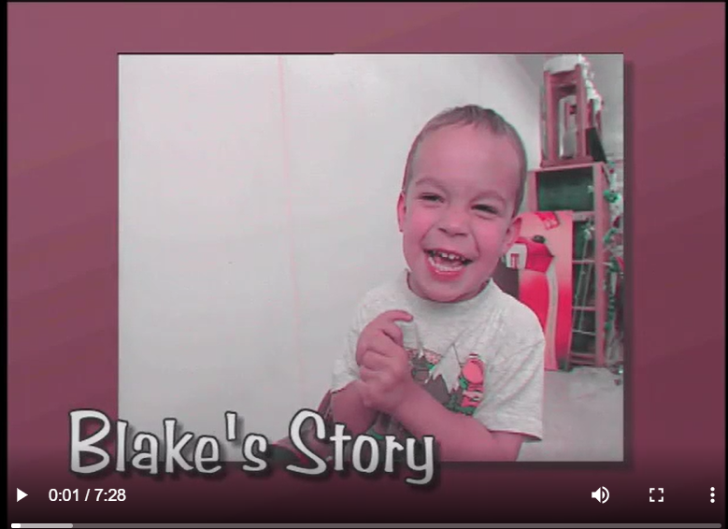
Video: Blake’s Story
https://www.cde.state.co.us/resultsmatter/blakesstory
Notes:
https://www.cde.state.co.us/resultsmatter/blakesstory

Slide 14
Planning: Determining Need for Specific Curriculum Modifications in Early Care Settings
Environmental supports
Materials adaptation
Activity simplification
Child Preferences
Assistive technology
Adult support
Peer support
Notes:
Building Blocks for Teaching Preschool Children with Special Needs, Sandall, S.R., Schwartz, I.S. et al., 2019

Slide 15
Environmental Supports
“Altering the physical, social, and temporal environment to promote participation, engagement, and learning”
Sandall, S.R., Schwartz, I.S. et al., (2019).
Notes:
Https://eclkc.ohs.acf.hhs.gov/children-disabilities/article/highly-individualized-teaching-learning
Building Blocks for Teaching Preschool Children with Special Needs, Sandall, S.R., Schwartz, I.S. et al., 2019

Slide 16
Environmental Supports
Maximize Access to Activities/Materials Based on Individual Needs
Environmental modifications provide multiple ways for a child to access learning opportunities
Increased access leads to increased participation
Participation provides many opportunities to learn in everyday social contexts
Notes:
https://eclkc.ohs.acf.hhs.gov/children-disabilities/article/highly-individualized-teaching-learning

Slide 17
Inclusive Learning Environments:
Increase child’s level of independence
Work because they do not single out a particular child
Empower the child
Permit teachers to be more efficient with their time
Notes:
https://eclkc.ohs.acf.hhs.gov/children-disabilities/article/highly-individualized-teaching-learning

Slide 18
Strategies for Environmental Support
Physical Adjustments:
  Changing use of space or arranging furniture
  Intentionally managing/adding/rotating materials
  Making boundaries easy to see
  Adding visual cues to limit the need for verbal directions
Notes:
https://eclkc.ohs.acf.hhs.gov/children-disabilities/article/highly-individualized-teaching-learning

Slide 19
Strategies for Environmental Support
Social adjustments to increase independence and participation:
Carefully selecting peer partners, grouping and seating arrangements to promote participation
Choosing preferred material to motivate shared play
Designing activities that promote social interaction
Notes:
https://eclkc.ohs.acf.hhs.gov/children-disabilities/article/highly-individualized-teaching-learning

Slide 20
Strategies for Environmental Support
Temporal adjustments:
Adjustments to schedule and time spent on tasks can promote participation of individual children
  Individualized activity schedule that builds in time for transitions
  Modifying amount of time expected or allowed for activities (e.g., circle time)
Notes:
https://eclkc.ohs.acf.hhs.gov/children-disabilities/article/highly-individualized-teaching-learning

Slide 21
Activity
Watch the video on the following slide then answer these questions;
Which type of environmental supports did you see used here (physical, social, temporal?)
Did these strategies support his full participation in the activity?
How so?
Notes:
https://www.youtube.com/watch?app=desktop&v=cPofHKsClBI&list=PLRFbj7RcOrU1eg1is9nWt-MVxz2vyg5ZQ&index=15

Slide 22
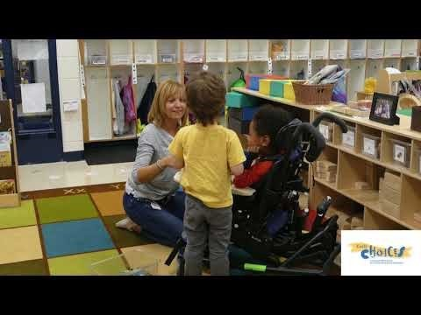
Activity
Supporting full participation during block play
https://youtu.be/cPofHKsClBI
Notes:
https://www.youtube.com/watch?app=desktop&v=cPofHKsClBI&list=PLRFbj7RcOrU1eg1is9nWt-MVxz2vyg5ZQ&index=15

Slide 23
Planning for the Use of Assistive Technology (AT)
Planning in the context of all learning environments should include the use of:
  Ecological assessments
  AT assessments
  Family-provided information
Should address the question, “how can this child participate independently?”

Slide 24
Levels of Assistive Technology
Technical Level | Purpose | Examples
LOW | Increase access to materials and activities | Page turners, slant boards, communication boards, visual schedules
MID | Provide choice, offer access to learning and social opportunities | Adapted toys, single/multiple message devices, software, touchscreens
HIGH | Provide vehicle for language through alternative speaking methods | Augmentative and alternative communication systems

Slide 25
Adaptive Equipment and Assistive Technology
A range of adaptive solutions that optimize a child’s access to activities and participation across contexts and routines
Examples
    Ramps for wheelchair access to play centers
    Wagons for transitions with the group when not practicing walking
    Bolsters and footrests to stabilize children at activity tables
    Beanbag/cube chairs
    Adaptive handles and scissors

Slide 26
Materials Adaptation
Change placement to maximize child access
Stabilize: Velcro, tape, nonskid surfaces
Modify to enhance participation (e.g., glue Styrofoam between pages of a book to make it easier to turn)
Create bold and simplified visual materials to attract and engage
Notes:
See: Sandall, S.R., Schwartz, I.S., Joseph, G.E., Gavreau (2019): Building Blocks for Teaching Preschoolers with Special Needs, 3rd Edition, Brooks

Slide 27
Activity Simplification
Break the activity down into smaller elements (e.g., provide one or several blocks at a time)
Reduce or change the order of required steps in an activity
Support children to move through an activity and have them complete the last step alone
  Gradually fade support throughout earlier steps

Slide 28
Individual Interests
Identify child preferences to plan activities for the whole group
Choose activities that include child strength areas
Include plans for peer support and shared enjoyment
Plan for predictable access to preferred objects and activities to support self-regulation

Slide 29
Adult Support Strategies
Join the child in play
Offer just the right amount of help
Highlight successes using descriptive praise
Slow down the pace when needed
Support peer interaction
Provide narrative comments
Provide modeling and expansions of play/social communication

Slide 30
Peer Support
Children often acquire new skills more effectively from peers than from adults/professionals
Hard-wired to learn in the context of social interaction with peers

Slide 31
Embedding Peer Interaction Into Every Part of the Day
Creating a culture in which children support each other creates trusting relationships, friendships, and a caring classroom community

Slide 32
Select Supportive Peers When Planning Instruction/Intervention
Consider the match between children in terms of complementary strengths and interests
Does the child want to help?
Generally, is the child patient, empathic, talkative, flexible, enthusiastic?
Use a period of observation to make your selection

Slide 33
Peer Partners
Can be planned in advance to:
  Encourage
  Model
  Help when needed
  Share delight
  Children with disabilities who share experiences with peers gain access to group membership, relevant behavior models, and positive learning experiences!

Slide 34
Peer Support at Preschool
Video 1.10: Routine in a program – water play | Connect Modules (dec-sped.org)
Watch the video on the next slide before discussing the following questions;
How did the teacher support the peer?
Did the child enjoy being invited into this activity?
As a teacher/provider, might you have done anything differently in this example?
Notes:
https://connectmodules.dec-sped.org/connect-modules/resources/videos/video-1-10/

Slide 35
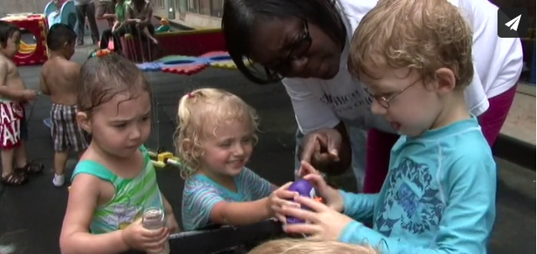
Video: Water Play
https://connectmodules.dec-sped.org/connect-modules/resources/videos/video-1-10/
Notes:
https://connectmodules.dec-sped.org/connect-modules/resources/videos/video-1-10/

Slide 36
Sibling Support
Video 1.13: Routine in the community – playing at a park | Connect Modules (dec-sped.org)
Watch the video on the next slide before discussing the following questions;
How did this sibling enrich her brothers learning during this outing?
What might you want to hold in mind for a sibling of a child with a disability?
Notes:
Facilitator can highlight the value of the sibling's support in terms of encouragement, support, and modeling and celebrate the warm connection they see in this example. This sister really seems to support this child’s sense of security and competence in the playground.
Support discussion that his sister is a child may be giving up some of her own ideas about how she would like to play at the playground if she were there alone with her mother. How can providers support the needs of siblings when making plans for learning opportunities?
https://connectmodules.dec-sped.org/connect-modules/resources/videos/video-1-13/

Slide 37
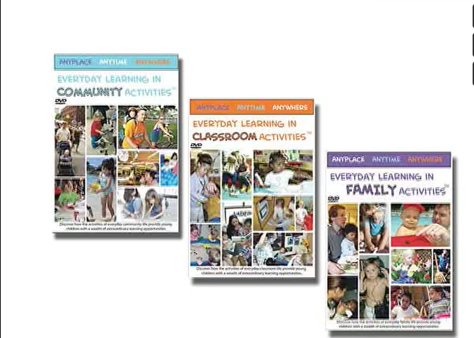
Video: Sibling Support
https://connectmodules.dec-sped.org/connect-modules/resources/videos/video-1-13/
Notes:
https://connectmodules.dec-sped.org/connect-modules/resources/videos/video-1-13/
https://vimeo.com/297451508

Slide 38
Activity
Video 1.17: Routine in a program – playing red light green light | Connect Modules (dec-sped.org)
Watch the video on the next slide before discussing the following questions;
How did these teachers bring in child preferences, peer support, and use environmental arrangements to support participation and learning?
Notes:
Assign partners to view the link together and report out.
https://connectmodules.dec-sped.org/connect-modules/resources/videos/video-1-17/

Slide 39

Video: Playing Red Light Green Light
https://connectmodules.dec-sped.org/connect-modules/resources/videos/video-1-17/
Notes:
https://connectmodules.dec-sped.org/connect-modules/resources/videos/video-1-17/

Slide 40
References and Resources
Sandall, S.R., Schwartz, I.S., Joseph, G.E., Gavreau (2019): Building Blocks for Teaching Preschoolers with Special Needs, 3rd Edition, Brooks
Connect Modules and the Division for Early Childhood (DEC)
The National Center on Quality Teaching and Learning: Highly Individualized Teaching and Learning
Activity Matrix for Young Children with Disabilities (odu.edu)
Notes:
https://connectmodules.dec-sped.org/
https://eclkc.ohs.acf.hhs.gov/children-disabilities/article/highly-individualized-teaching-learning
https://ttac.odu.edu/early-childhood/activity-matrix-for-young-children-with-disabilities/

Slide 41
Disclaimer

